Slide 1
Noise Pollution Monitoring Using IOT
Team members
1. Mohan Krishna
2. Vignesh Kumar
3. Pavan Kumar
4.Yeswanth
5.shaik Kaif

Slide 2
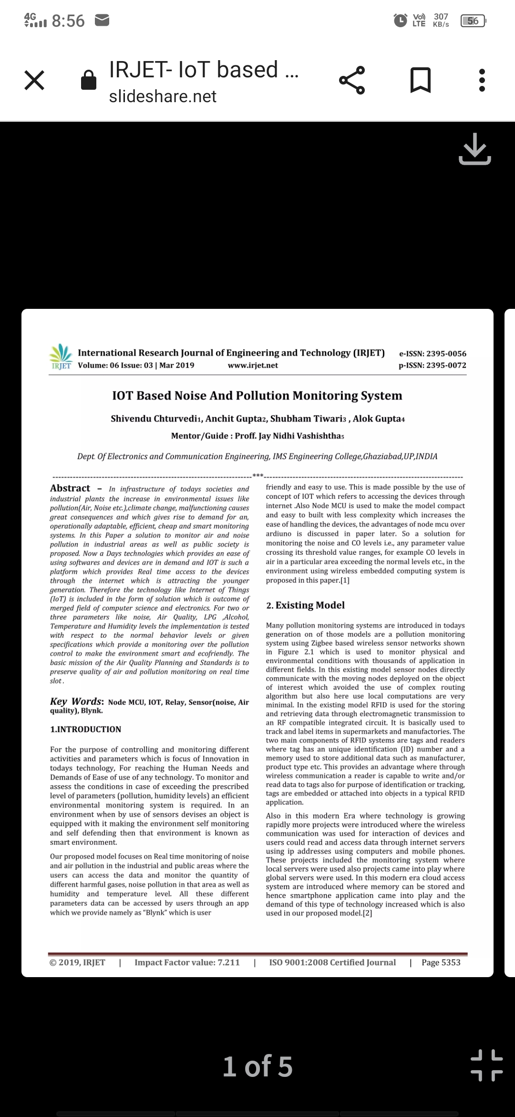

Slide 3
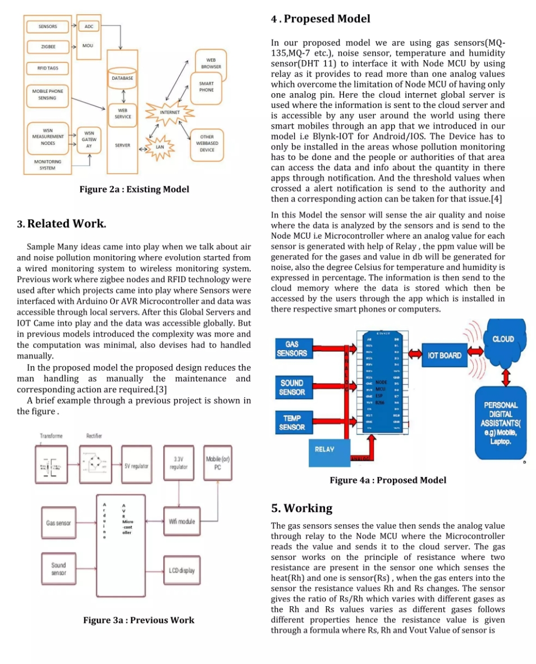

Slide 4
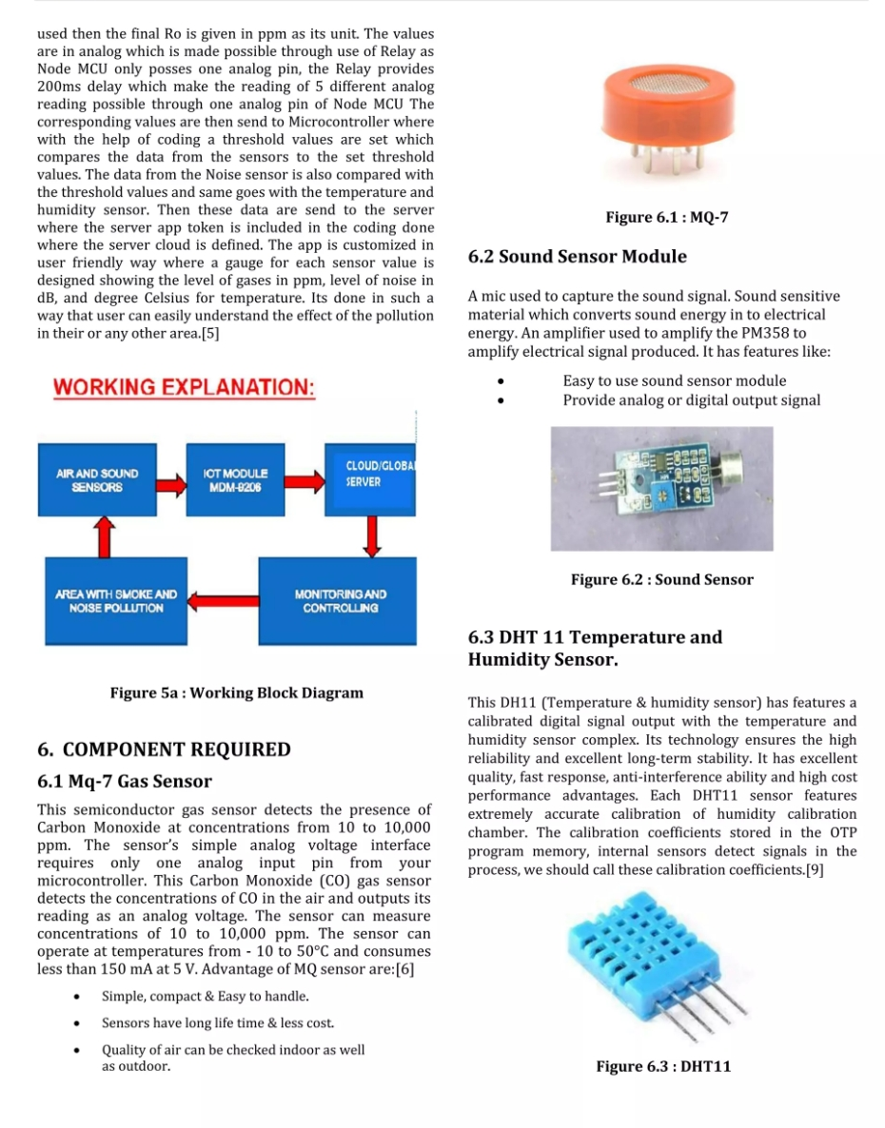

Slide 5
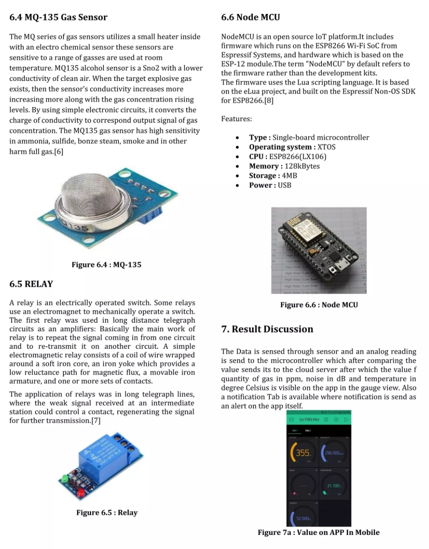

Slide 6
